Slide 1
Topic: How is Chinese aid primarily channeled? Is it towards nations that have poor governance, significant poverty levels, or those that maintain strong diplomatic relations with China? Understanding determinants of Chinese aid and other forms of state financing.
By: Kalide Endale

Slide 2
Agenda
Introduction
Background
Data Sources
EDA
Empirical Analysis
Robustness Check & Further Research
Conclusions

Slide 3

Introduction: rise of a new superpower as an Aid Provider
The literature on Chinese Official Finance points to different phases of geopolitical strategy.
During the period of 1956-1960, its believed that China’s motives for aid was largely motivated by political and ideological considerations.
By 1969, after 9th National Congress, it is believed there was a shift in priority for aid. During this phase (2nd phase: 1970-1978), aid was used to garner support for One China policy (also known as the period of checkbook diplomacy). It is during this period we see a lot of African countries sever their ties with Taiwan.
The third phase (1979-1989) is the period of reform under the leadership of PM Deng Xiaoping. China during this period liberalized its economy and became more influential in China’s aid allocation decisions (Resource driven).
The fourth period (1990-1995), this era of Chinese aid policy was guided by the aftermath of the Tiananmen Square incident in 1989(Buying Influence). After this moment, China actively sought diplomatic support and increased aid substantially to African and Latin American allies to reward their ”all-weather friends”.
China’s fifth period (1996-2006), aid was reformed, introducing market-oriented principles and emphasizing linkages between aid, trade and investment (Brautigam 2009).

Slide 4
Why is Chinese Aid Interesting?
The Development Assistance Committee (DAC) is the governing body of 24 countries that standardized what is considered concessional aid, Official Development Assistance (ODA) and what is not in regard to development, a residual category called Other Official Flows (OOF)
These standards and reporting procedure were set in place as early as 1972
All western power. At the time of defining Aid, China was an Aid recipient country, so they played no role in shaping this definition
However, as China becomes an increasingly important player in the Aid game, this has provided recipient countries with another alternative set of financing.
This new financing channel have troubled Scholars, since 1) China doesn’t follow the internationally standardised rules for financing set by the DAC countries. 2) China doesn’t publish data on this Aid activities
This visible difference in Aid game has created an apple to oranges issue. That is, we cannot at face value compare the aid that China provides since the rules that govern ODA financing for DAC countries and China are different.
Typically, DAC countries provide loans that tied to conditions that liberalize the economy, reduce the role of governance, democratize the government and restructuring debt. Furthermore, DAC has shifted towards assisting in social sectors: education, women's health, etc..
China’s aid takes many forms. China provides packages that bundle together finance from several different windows: some concessional and some of it market rate. Additionally, China is also known to underwrite risky loans via resources secured lending, investing in sectors DAC countries generally avoided
China also adopted a policy of non-interference, encouraging African countries to find political and economic models of development to suit their own particular circumstances

Slide 5
Data Sources
As stated earlier, data on Chinese Official Finance is Dearth.
To Combat this issue, College of William and Mary (aid data) and number of universities collaborated to create one of the few large database on Chinese Official finance at the project level
The project scraped articles on project announcement and commitments from the Chinese Government, SOE, or Policy banks. This was done by looking at announcements from the likes of governments, intergovernmental organizations, non-governmental organizations, research institutions, etc..
The current version (the most updated) has project level data from 2000 – 2017. There are 13,428 projects recorded and standardized so far. Researchers have noted Total commitments amounts, the flow class, the dispersing agency, the recipient country, and so on.
Other data sources:
To complete this data set, I’ve collected data from the world bank that captures the characteristics of countries
Pulled Electoral Democracy data Index from Our World in Data (based on OWID V-Dem), that measures economic freedom in each country (proxy for high quality institutions)
Collected data on countries diplomatic relationship with Taiwan
Collected data on disasters from OCHA (reliefweb)

Slide 6
Literature Review
China’s official aid programme is widely misunderstood. A large reason for this lies in a lack of transparency by the Chinese government regarding their flows of official aid and other official finance. At the same time, however, considerable public information does exist (Bräutigam, 2009)
Nielsen (2011) studying the withdrawal of AID by DAC countries shows that sudden aid shocks significantly increase the likelihood of conflict onset. By adding Chinese funding data, the results suggest that sudden withdrawals of traditional aid are only more likely to induce conflict in the absence of sufficient alternative funding from China.
Alesina and Dollar (2000) finds that colonial past and political alliances are major determinants. a non-democratic former colony receives almost 25 dollars per capita, a democratic non-colony about 14 dollars per capita.
Dreher (2018) ODA-like flows and grants are guided more by foreign policy interests than other types of official financing. Second, less concessional forms of official finance are influenced to a larger degree by economic considerations (H2).
Dreher (2018) Commitments of OOF-like financing are significantly and positively correlated with trade, while this is not true for ODA-like flows. Further, they find out that Chinese ODA to Africa is strongly oriented toward poorer countries and OOF with stronger more advanced economies
Dreher (2018) Countries that have befriended China, as measured by their voting in the UNGA, get punished for being friendlier with the West, as indicated by their UNSC membership
Broich (2017) Chinese development finance does not systematically flow to more authoritarian countries, controlling for strategic, economic, political, institutional and geographic confounding factors.
Cooper (2019) Chinese investment supports national economic growth and is servicing Africa’s widely acknowledged infrastructure gap: a small body of rigorous evidence, largely derived from AidData datasets on Chinese investment in Africa, finds that Chinese investments have positive economic growth impacts including increases in GDP and flattening spatial inequalities.

Slide 7
Exploratory Data Analysis

Slide 8
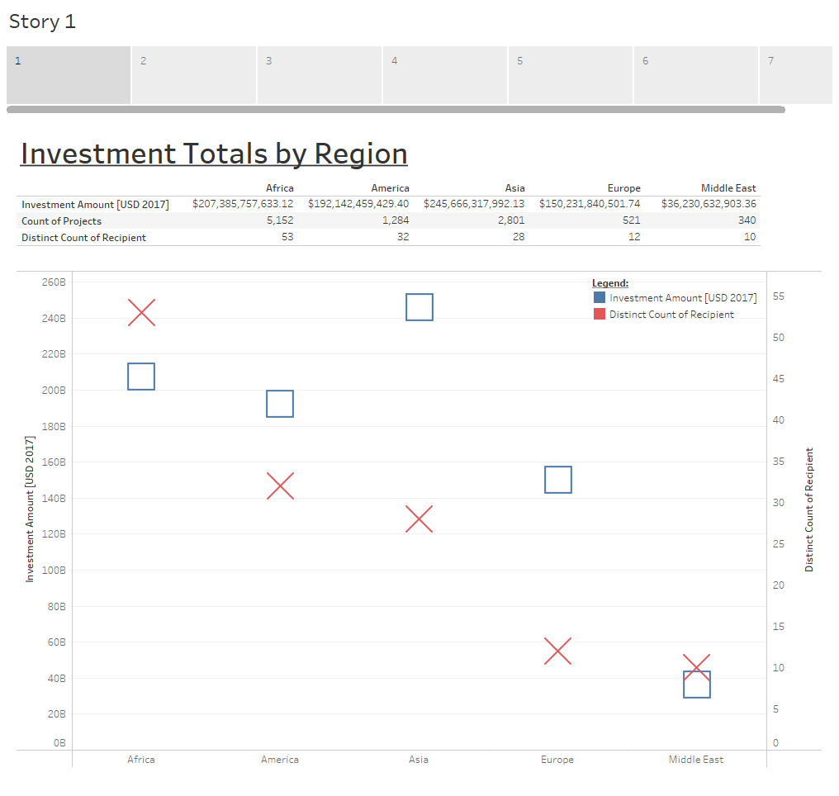

Slide 9
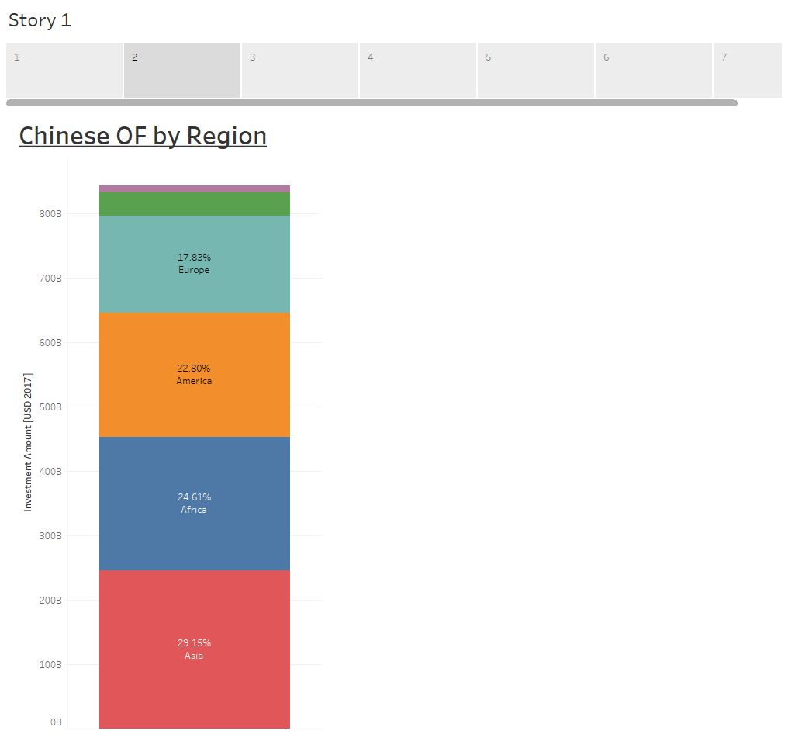

Slide 10
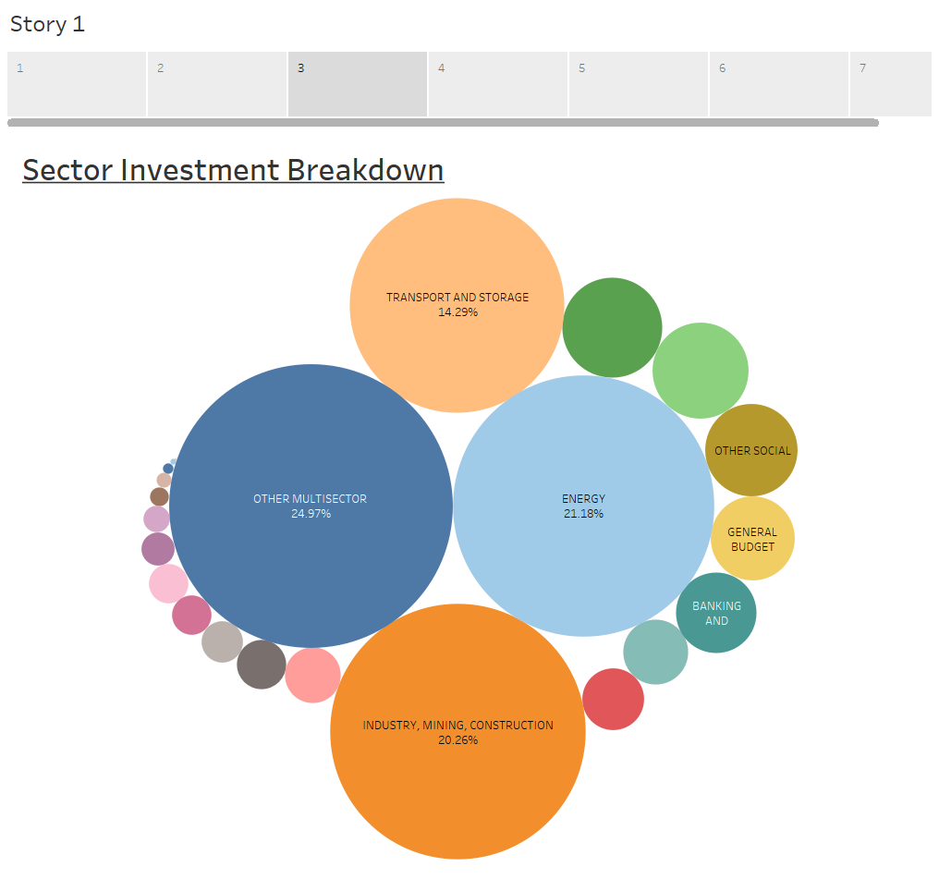

Slide 11
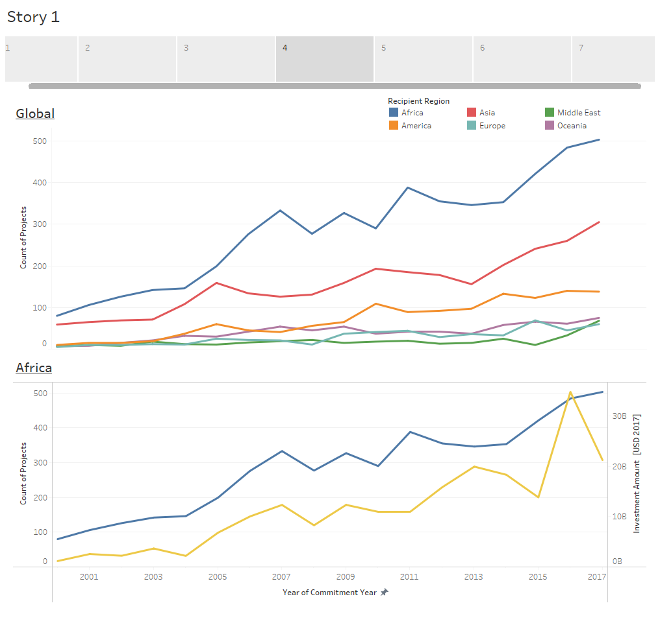

Slide 12
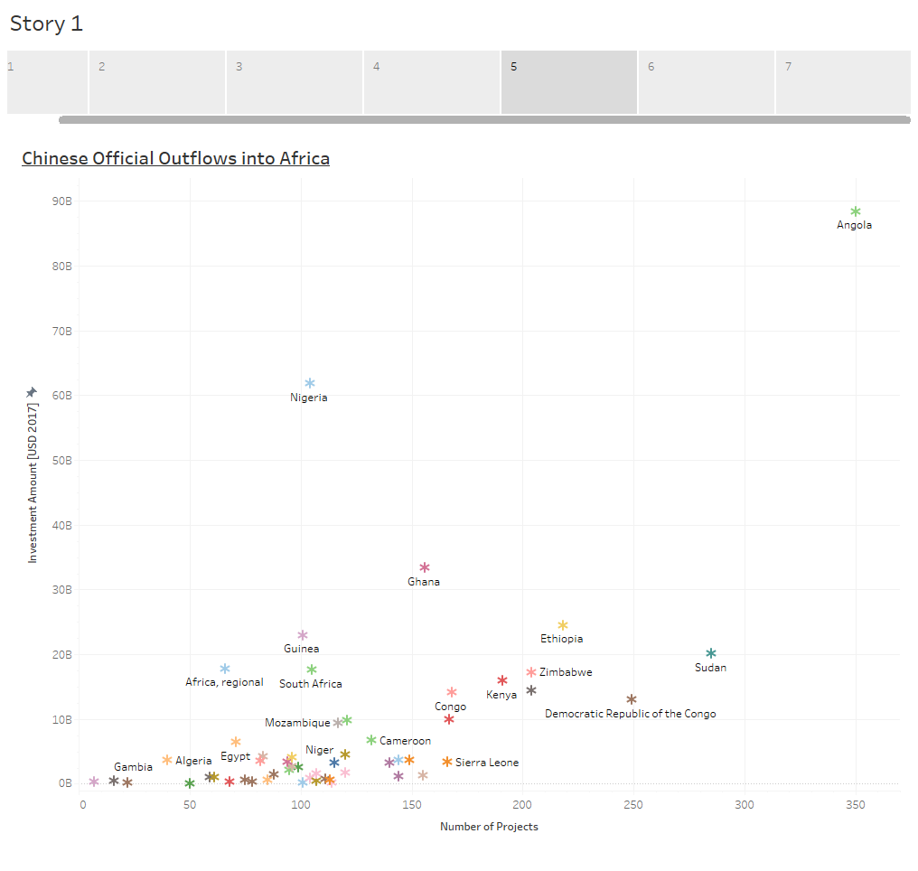

Slide 13
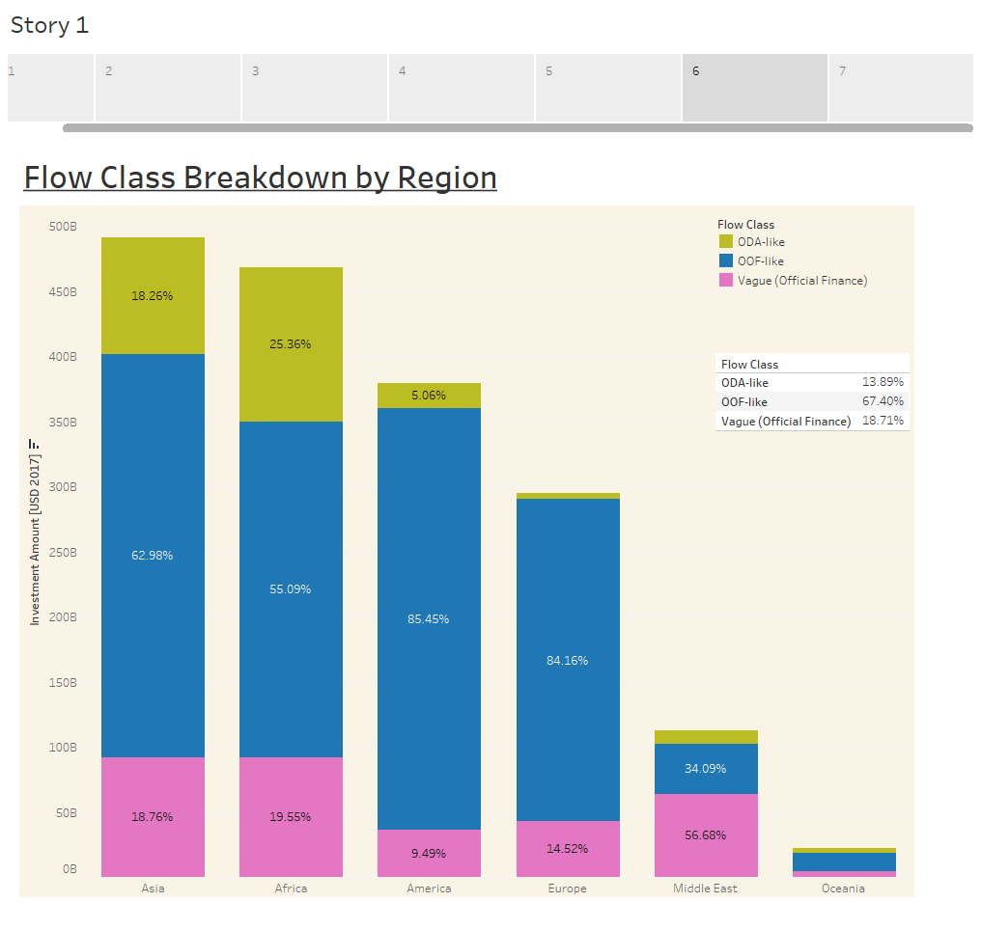

Slide 14
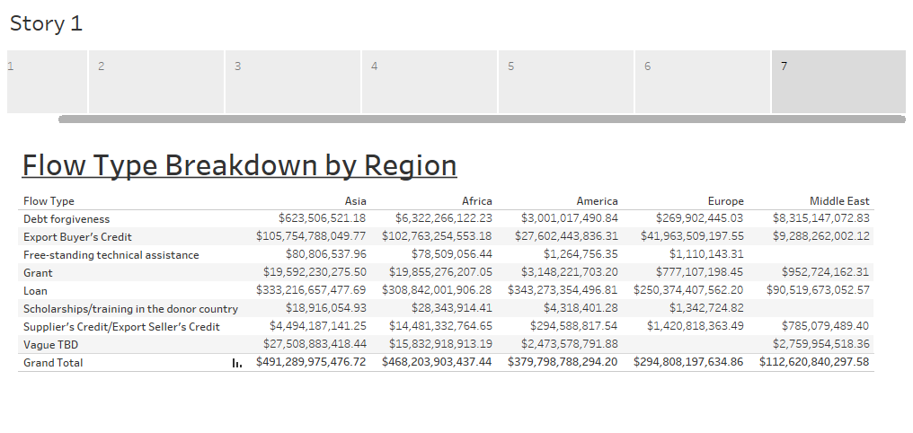

Slide 15
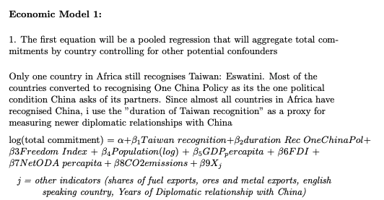
Empirical Analysis
I will be creating 2 different sets of equations for my research paper
Due to restrictions with time: I’m not able to dive deeper into the data and tease out further relationships or control for endogeneity beyond what’s I’ve done in these two models.

Slide 16
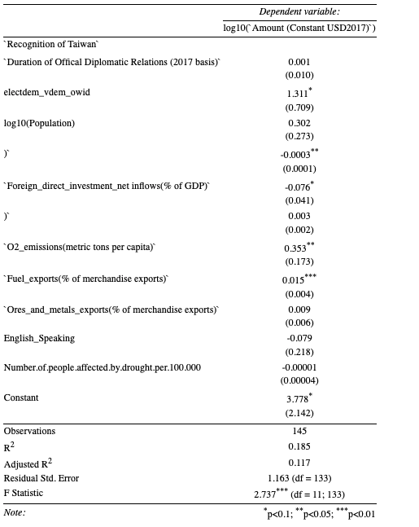
Results #1
markdown

Slide 17
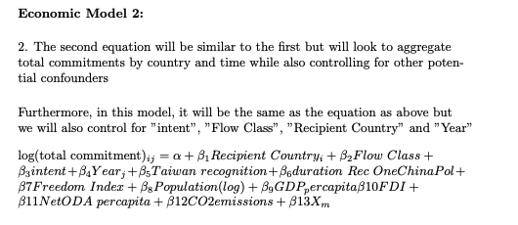

Empirical Analysis
I will be creating 2 different sets of equations for my research paper
Due to restrictions with time: I’m not able to dive deeper into the data and tease out further relationships or control for endogeneity beyond what’s I’ve done in these two models.

Slide 18
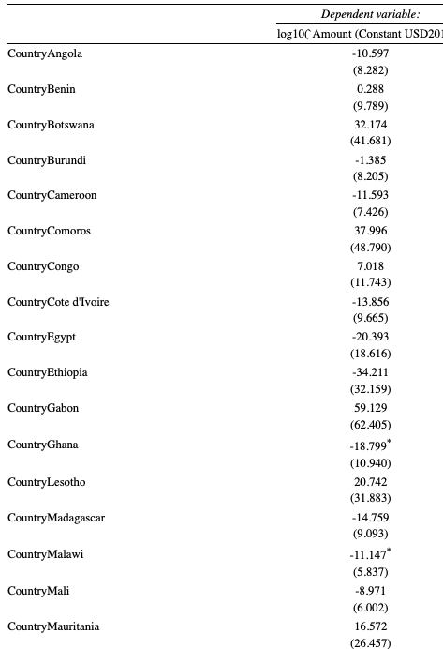
Results #2

Slide 19
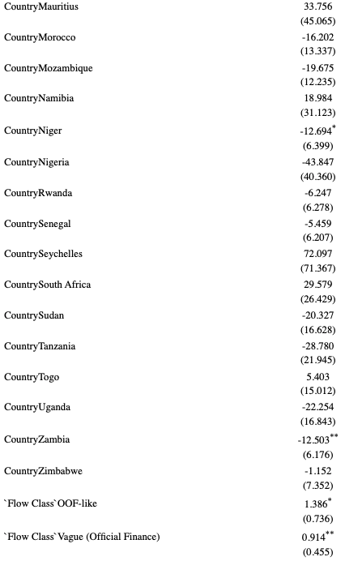
Results #2

Slide 20
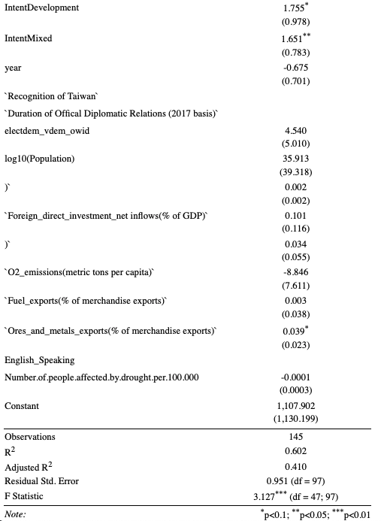
Results #2

Slide 21
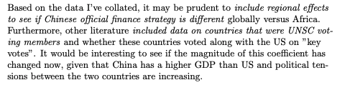

Robustness Check & Further Research
Model could be improved/strengthened in various ways:
Substitute different indexes for the Institutional proxy
Run a control for aid dependency (can be proxied Chinese OF as a share of the recipient's GNI)
Alternatively, there could be other factors that would improve the power of our model if we controlled for it
A few other comments are provided below:

Slide 22
Conclusion
Western Scholars have traditionally labelled Chinese aid as “rouge” because it was believed that China was 1)undermining the efforts DAC countries have made in creating a stable Africa via their conditionalities
However, because of the emergence of data, we are beginning to econometric evidence that this isn’t the case
Although China’s approach to aid is different, it is providing African countries with optionality and helping building infrastructure (considered a riskier investment by DAC country partners)

